Slide 1

House Prices Prediction Project
A Machine Learning Approach to Predict Real Estate Prices

Slide 2
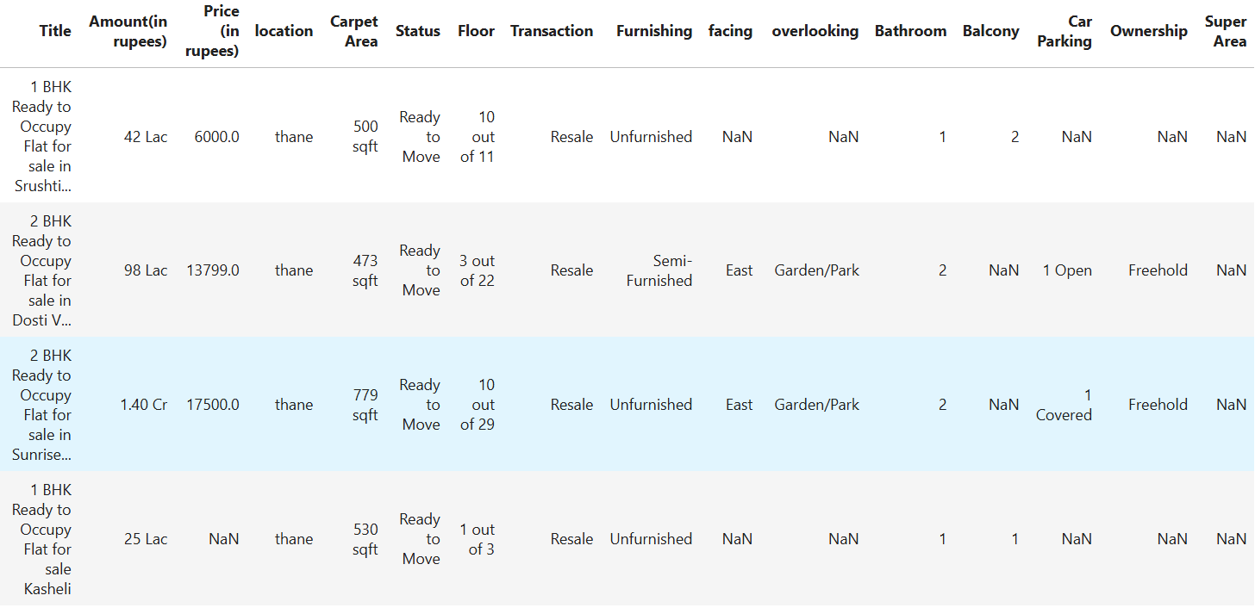


Objective
Attributes:
Title, Amount, Price , location, Carpet Area, Status, Floor, Transaction,
Furnishing, facing, overlooking, Bathroom, Balcony, Car Parking,
Ownership, Super Area
Dataset Size:187531 rows,21 columns
This project aims to predict house prices using Machine Learning models.
The goal is to analyze pricing trends and build a predictive model for accurate amount estimation.

Slide 3
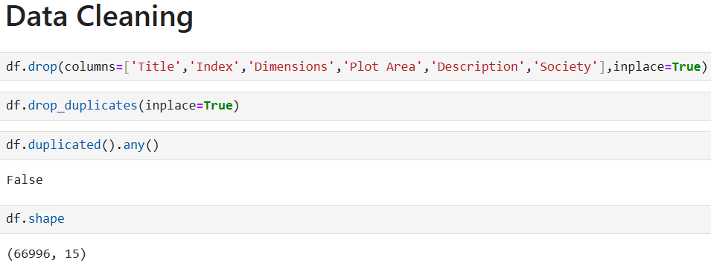
Data Cleaning and Preprocessing
Removed irrelevant columns (Index, Description, Dimensions, etc.
Converted price formats (Lac, Cr) into numeric values
Handled missing values using mode and median imputation
Converted categorical features like floor and furnishing

Slide 4
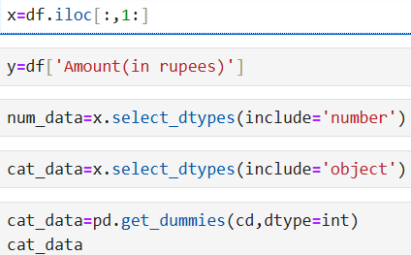
Feature Engineering
Feature transformations performed:
Converted Floor levels (Ground, Upper) into numeric values
Standardized area measurements (sqft, sqyrd, acres, etc.)
One-hot encoded categorical variables.

Slide 5
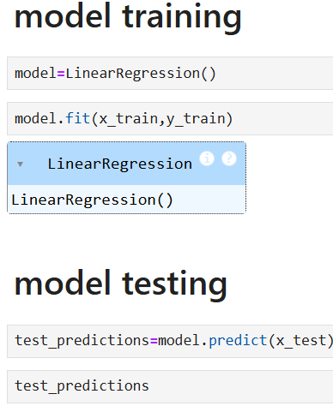
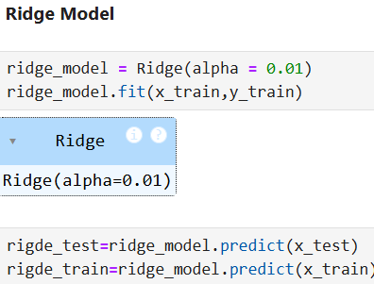
Machine Learning Models Used
The following models were implemented:
Linear Regression
Ridge Regression
Lasso Regression

Slide 6
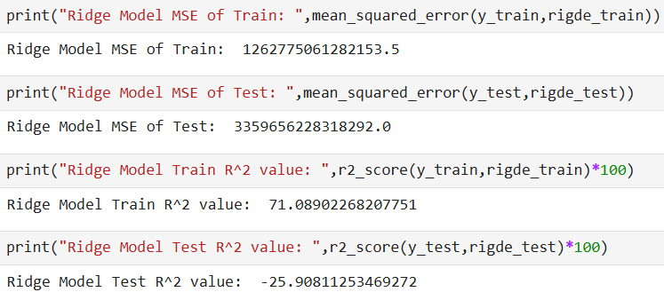
Model Evaluation & Results
Performance metrics used:
Mean Squared Error (MSE)
R-squared Score (R²)
Best-performing model: Ridge Regression with the lowest error and highest R² score.

